Slide 1
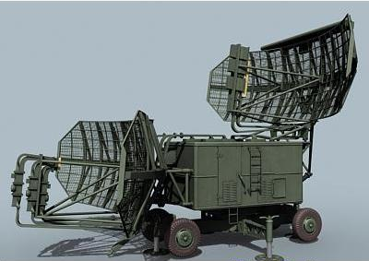
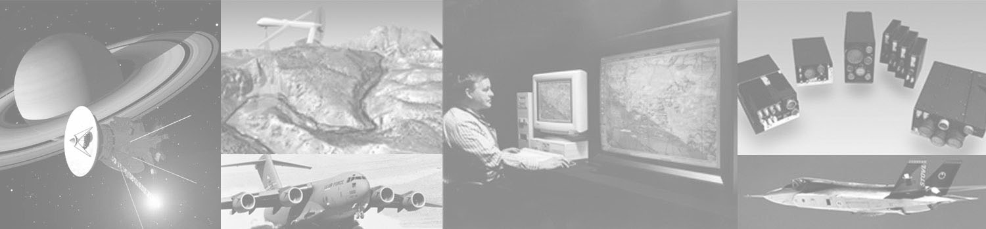
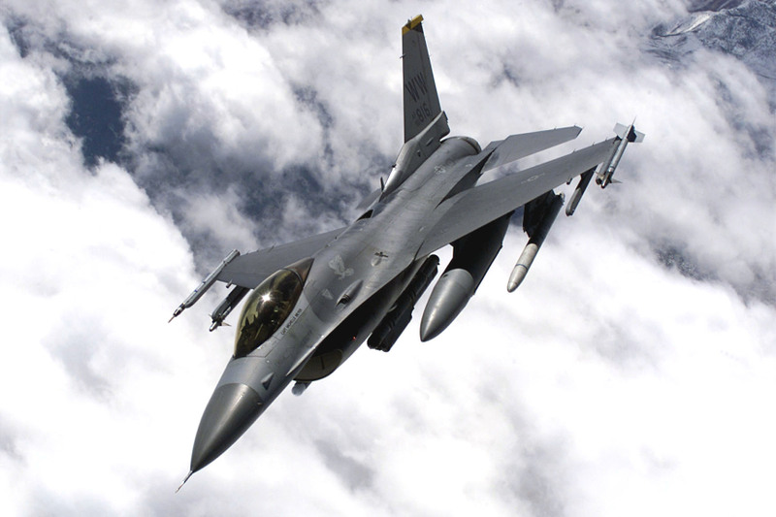
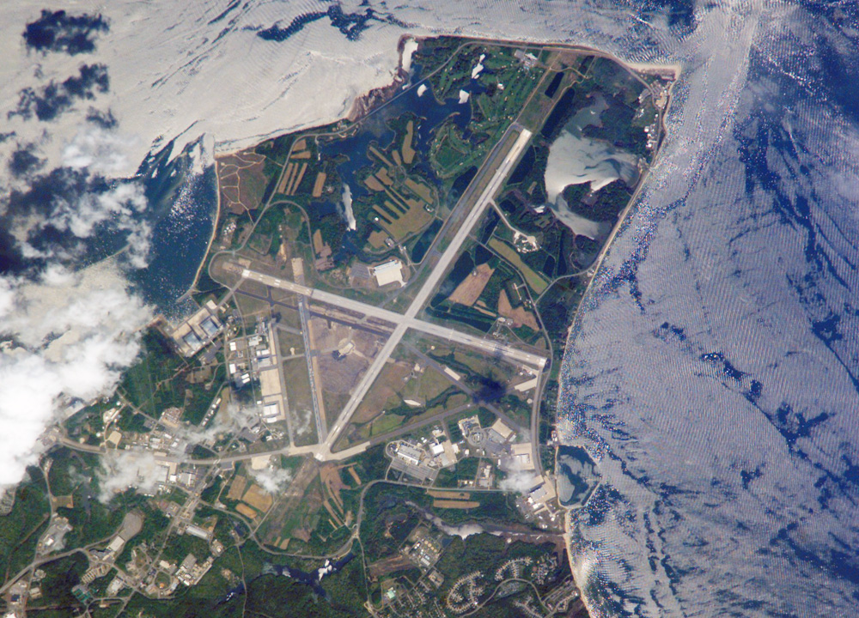
RF EW – RADAR System Test Plan
Team Finck BIG!
Bryan Finck, David Horne, Carlos Lazo, Rowland Stilwell

Slide 2
Agenda
Problem Definition
Requirements
Test Methodology
Test Plan

Slide 3
Problem Definition
Problem Set
  RADAR is a stationary Early Warning RADAR (EWR)
  Detection of two targets:
    At Maximum Range
    Separated by at least a minimum range resolution
    Greater than a minimum RCS
Test Objective
  Can our RADAR:
    Detect when target platforms enter detectable range?
    Detect two targets when they are within the minimum range resolution and detectable range?

Slide 4
System Requirements
Req’t ID # | Requirement | Verification Method
SYS_01 | The RADAR shall have a maximum detectable range of at least 194.865 km | T
SYS_02 | The RADAR shall be capable of detecting targets at maximum range at least 95% of the time | T
SYS_03 | The RADAR shall be capable of detecting target position with a minimum accuracy of 90% | T
SYS_04 | The RADAR shall be able to detect a target with a minimum RADAR Cross Section (RCS) of one square meter | T
SYS_05 | The RADAR shall have a minimum sensitivity of -126 dBm | T
SYS_06 | The RADAR shall be capable of detecting two targets which are at least 180 m apart at the maximum detectable range | T
SYS_07 | Input power shall not exceed 100 watts | I
SYS_08 | Weight shall not exceed 20.1 tons | I
SYS_09 | Size shall not exceed the dimensions of 10 m x 10 m x 10 m (LxWxH). | I
SYS_10 | The RADAR shall be capable of detecting the azimuth angle, elevation angle, and range of a target | T
SYS_11 | The RADAR beam width shall be 2 degrees +/- .1 degrees | T
SYS_12 | The RADAR shall have 500 megabytes of storage allocated for flight test data | I
SYS_13 | The RADAR shall have an operating frequency of 3.3 GHz +/- 416 MHz | T
SYS_14 | The RADAR shall have a bandwidth of 833 MHz | T
SYS_15 | The RADAR shall have a minimum spin rate of 36 degrees per second | A
SYS_16 | The RADAR shall store detection data every 0.001 seconds | T
SYS_17 | The RADAR shall be capable of operating when exposed to temperatures between -50 °C and 60 °C | T
SYS_18 | The RADAR shall be capable of operating when exposed to a maximum environmental loss of 6 dBi | T
A = Analysis
I = Inspection
T = Test

Slide 5
Test Plan Requirements
The test plan will verify the following subset of the System Requirements:
Further test plans would be developed to verify the remaining System Requirements
Req’t ID # | Requirement | Verification Method
SYS_01 | The RADAR shall have a maximum detectable range of at least 194.865 km | T
SYS_04 | The RADAR shall be able to detect a target with a minimum RADAR Cross Section (RCS) of one square meter | T
SYS_06 | The RADAR shall be capable of detecting two targets which are at least 180 m apart at the maximum detectable range | T
SYS_10 | The RADAR shall be capable of detecting the azimuth angle, elevation angle, and range of a target | T
SYS_16 | The RADAR shall store detection data every 0.001 seconds | T

Slide 6
Measures of Effectiveness (MoE)
Binary detection of RADAR Cross Section (RCS) Reflector
  Detection of RCS Reflector proves RADAR is operational
  Accurate calculation of latency at maximum range
Consistency between the target and RADAR detection ranges
Number of targets detected by the RADAR

Slide 7
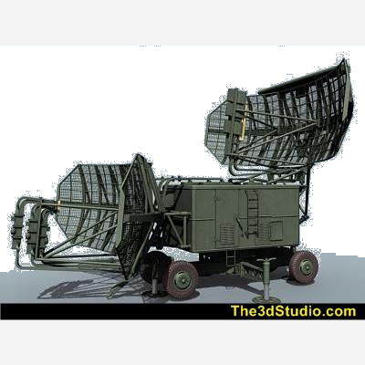
RADAR Description
Early Warning RADAR (EWR) with elevation and azimuth detection capabilities
Modeled after the Russian P-37 Bar Lock EWR
Variable | Value | (Units)
Transmit Power | 100000 | W
Tx Gain | 30 | dBi
Rx Gain | 30 | dBi
Frequency | 3300000000 | Hz
Wavelength | 0.090846199 | m
Pulse Repetition Frequency (PRF) | 769.2307692 | Hz
Pulse Repetition Interval (PRI) | 0.0013 | s
Pulse Width | 0.0000012 | s
RADAR Cross Section (RCS) | 1 | m²
Sweep Rate | 36 | deg/sec
Range Resolution | 180 | m
Weight | 40200 | lbs
Size | 10 (L) 10 (W) 10 (H) | m

Slide 8
Test Range and Target Requirements
Target Requirements
  Selected Target: F-16 C
Test Range Requirements
  Selected Test Range: Patuxent River
Target | Desired | Selected
RADAR Cross Section | 1 m² | 1 m²
Altitude | 11 km | 9 – 12.2 km
Test Range | Desired | Selected
Range | 400 km² | 5.9 x 10⁴ km²
Target Altitude Limit | > F-16 C Desired Height | 25.9 km
RADAR Altitude | Sea Level | Sea Level
Nominal Operating Temperature | 16°C | Month: October Nominal: 16°C Range: 12-20°C
Airspace | 2.5 x 10⁵ km² | 7 x 10⁹ km²

Slide 9
Workforce Allocation
Title | Required Personnel | Effective Man Hours
Software Engineer | 1 | 16 Hours
Systems Engineer | 2 | 32 Hours
Technical Support | 3 | 26 Hours
Ground Crews (3) | 6 | 5 Hours
F-16C Pilots | 2 | 8 Hours
Total | 10 | 87

Slide 10
Test Instrumentation
The following materials are needed to run this test:
Description | Quantity | Manufacturer | Model / Part #
F-16 C with GPS Recorder and COMM Radios | 2 | Lockheed Martin Corporation | R2D2
RCS Reflector Test Point with GPS Recorder | 1 | Northrop Grumman | C3PO
Ground COMM Radio Receiver at RADAR Station | 1 | BAE Systems | 10-10-321
Scorpion RDS Ruggedized Portable Maintenance Aide (PMA) | 1 | DRS Technologies | 8675309
Perl Script for Data Fusion CM226 | - | BAE Systems | RADAR_dfuse.pl

Slide 11
Test Methodology
Stationary RCS Reflector with an RCS of 1 m² will be used to determine that the RADAR is operational
The RCS Reflector will be located at the maximum range of the RADAR
The RADAR will receive a signal from the RCS Reflector and use the Time of Arrival to:
  Prove the RADAR is operational
  Determine the return signal latency that is caused by environmental interference
THE RESULT IS TARGET PLATFORM DATA AND DETECTION DATA CAN BE CORRELATED BY TIME
Notes:
The Reflector will be placed in the area where the target platforms will enter the detection area

Slide 12
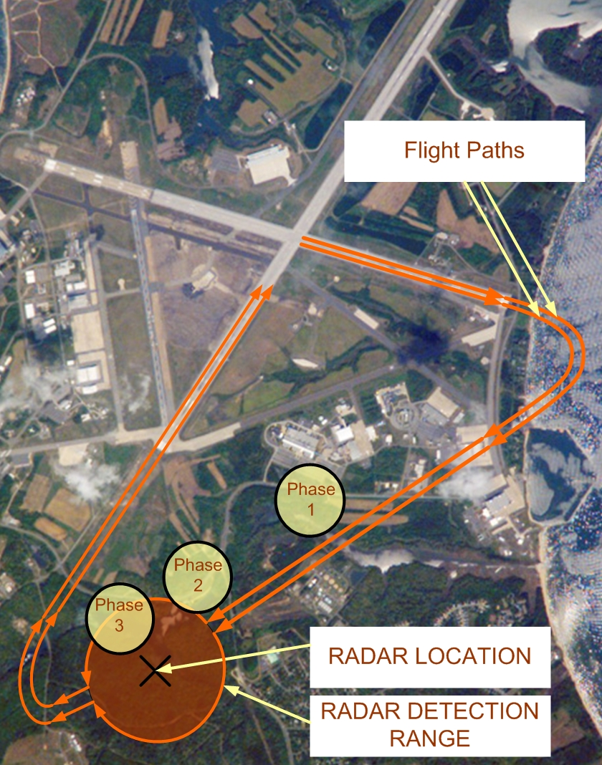
Test Methodology
Phase 1: Targets are out of maximum range
Phase 2: Targets are at maximum range, and within the RADAR range resolution
Phase 3: Targets are at maximum range, and not within the RADAR range resolution

Slide 13
Test Plan
Test plan divided into three major sections:
  Operational Check via RCS Reflector
  Target Flight
  Post-Processing
Operational Check via RCS Reflector
  The RADAR initially will focus the antenna arrays at sea level
  The RADAR will scan a 1 degree area where the target will enter from the center
  The RCS Reflector will be located in the center of this scan area
  Detection of RCS Reflector will prove the RADAR is operational at maximum range
Target Flight
  Targets embark on flight path
  The RADAR will focus its main beam at 9.144 km in elevation while continually scanning the same 1 degree area in azimuth
  Targets will enter detectable range within RADAR range resolution
    This will cause a single detection by the RADAR
  Targets will fly away from each other while remaining at the maximum range
    RADAR will see both targets once they are further apart than the RADAR range resolution

Slide 14
Test Plan
Post-Processing
  Data is downloaded from the:
    RADAR detection memory and GPS unit
    Target Platform GPS units
    RCS Reflector GPS unit
  Target Position
    Target GPS position data is used to calculate range, azimuth, and elevation
  Time of Arrival Latency
    RCS Reflector and RADAR GPS positions are used to determine the RCS Reflector range
    Time of arrival data from RCS Reflector ping is used to determine one way latency time
    This latency time is used to correlate target GPS position data with RADAR detection data
  Target Detection
    Use the correlated range data to verify:
      RADAR detections of one or two targets
      Minimum range resolution for two-target detection

Slide 15
Expected Results
The RADAR shall have a maximum detectable range of at least 194.865 km
  When the targets are outside the maximum range of the RADAR, they will not be detected
The RADAR shall be able to detect a target with a minimum RADAR Cross Section (RCS) of 1 m²
  Targets with an RCS of at least 1 m² will be detected by the RADAR
The RADAR shall be capable of detecting two targets which are at least 180m apart at the RADAR’s maximum detectable range
  Aircrafts within the arc of the RADAR’s maximum range will be detected as one target if they are not flying at least 180 m apart from one another
  Aircrafts flying within the arc of the RADAR’s maximum range will be detected as two separate targets if they are at least 180 m apart from one another
The RADAR shall be capable of detecting the azimuth angle, elevation angle, and range of a target
  The time-tagged position detection data of the RADAR should match that of the target platform
The RADAR shall store detection data every 0.001 seconds
  Data recordings should be made at every 0.001 seconds

Slide 16
Questions?

